Slide 1

Water Reminder
Application that gives life!

Slide 2
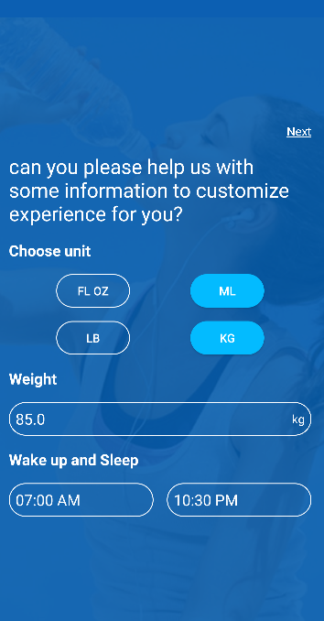
The application welcomes it’s users with a screen in which they can enter their data.

Slide 3
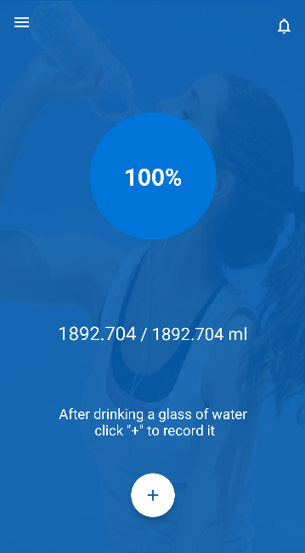
You will then be greeted from the home screen of the app.

Slide 4
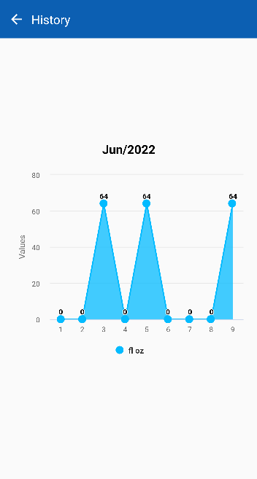
The application has a so-called room database, through which you will be sure how much water you have taken in recent days.

Slide 5
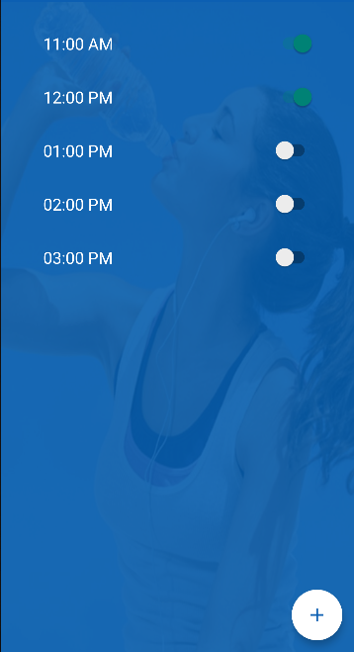
If you happen to be one of those people who forget that they need to consume water, you can use the reminder!

Slide 6
Thank you for your attention!
Prepared by: Tony Todorov

